Slide 1

GURU NANAK INSTITUTIONS TECHNICAL CAMPUS (AUTONOMOUS) DEPARTMENT OF ELECTRICAL AND ELECTRONICS ENGINEERING
TOPIC : RENEWABLE ENERGY SOURCE AND GRID PROTECTION
Presented by : G.Manojkumar
17WJ1A0233

Slide 2
INTRODUCTION
RENEWABLE ENERGY SOURCE
DEF : The Energy resources which can be used to produce again and again are known as renewable energy sources.
Renewable energy capacity additions in 2020 expanded by more than 45% from 2019, including 90% more new wind power(green) and a 23% expansion of new solar photovoltaic.

Slide 3
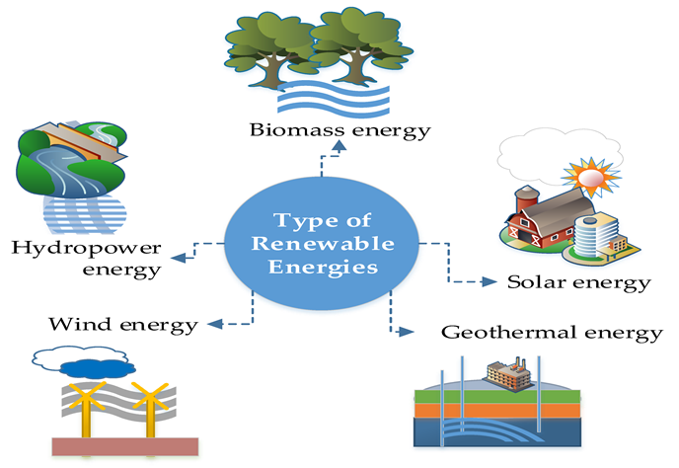
Major form of renewable energy sources
The main items under RES are as follows:
Wind Power
Solar Power
Hydro Power
Geothermal
Biomass Energy

Slide 4
Smart grid
A smart grid is an electricity network enabling a two-way flow of electricity and data with digital communications technology enabling to detect, react and pro-act to changes in usage and multiple issues.
Smart grids have self-healing capabilities and enable electricity customers to become active participants.

Slide 5
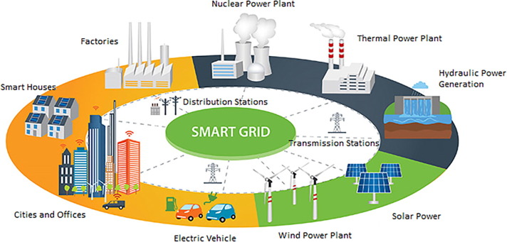
Smart grid

Slide 6
Integration of renewable energy sources in smart grid
Smart grid is nothing but the electricity network that smartly integrates producers and consumers to efficiently deliver electricity which is sufficiently capable and coverage area accessible, safe, economic, reliable, efficient, and sustainable.
Smart grids include centralized and distributed power generation produced considerably by renewable energy sources. They integrate distributed and active resources (i.e. generation, loads, storages and electricity vehicles) into energy markets and power systems.
The most exploited renewable energy sources are hydel energy, wind and photovoltaic sources.

Slide 7
Wind energy integration in smart grid
Integration of wind energy to the grid in terms of increasing efficiency can enhance the power output of the Smart Grid Technology. Based on the block diagram we can divide the whole system into three major parts. Beside the wind turbine, there are:
Turbine and speed control box
Wind interfacing box and
Grid Connectivity & Transmission to the AC Grid

Slide 8
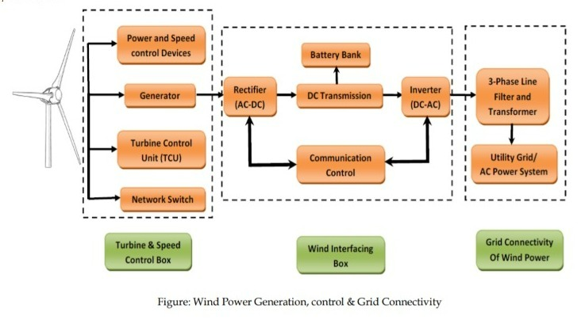
block diagram

Slide 9
Wind energy integration in smart grid
Turbine and Speed Control Box consists of Power and Speed Control devices such as gear boxes etc, generator, turbine control unit and network switches.
Wind Interfacing Box consists of AC to DC rectifier as the electricity generated from the wind turbine is AC. This rectified DC electricity is transmitted through the DC transmission line and then feed into Battery Bank as the reserve system for further use of electricity. Then the DC transmission line is directed to the DC to AC inverter for the transformation of AC electricity.

Slide 10
Wind energy integration in smart grid
There is communication control that is done for the purpose of controlling the battery charging and preventing the overcharging problem of battery which affects the battery life span and also the charging limit from the very first time of getting overcharged. These types of communication are done by the optical fibers.
The Grid Connectivity unit is mainly serving the inverted AC electricity directing to the three phase power line and filters. This is how the AC electricity generated from wind turbine is connected to the grid.

Slide 11
BENEFITS OF INTEGRATING WIND ENERGY TO THE GRID
Enhancing the efficiency of the Smart Grid
Enriching the power output by adding to the generated electricity and transmitted electricity.
No fuel consumption while generating electricity.
Low maintenance cost
Efficient in terms of longer payback period.

Slide 12
solar energy integration in smart grid
There are two types of solar power generation used in integration with grid power - concentrated solar power (CSP) and photovoltaic (PV) power. CSP generation, sometimes known as solar thermal power generation, is much like conventional thermal power generation that converts thermal energy (steam) into electricity.
Concentrated solar power systems (CSP) can store energy using thermal energy storage technologies. This capability to store thermal energy has led to better penetration of solar thermal technology using CSP in the power generation industry.
CSP systems are more attractive for large scale power generation as thermal energy storage technologies. Although CSP has better performance for grid integration.

Slide 13
solar energy integration in smart grid
Photovoltaic plant which uses PV modules to feed into the grid essentially consists of different components, but basically the inverter is the most important component for integration.
Photovoltaic (PV) solar panels differ from solar thermal systems in that they do not use the sun’s heat to generate thermal power, instead they use sunlight through the ‘Photovoltaic effect’ to generate direct electric current(DC). The direct current is then converted to alternating current, usually using inverters and other components, in order to be distributed onto the power grid network.

Slide 14
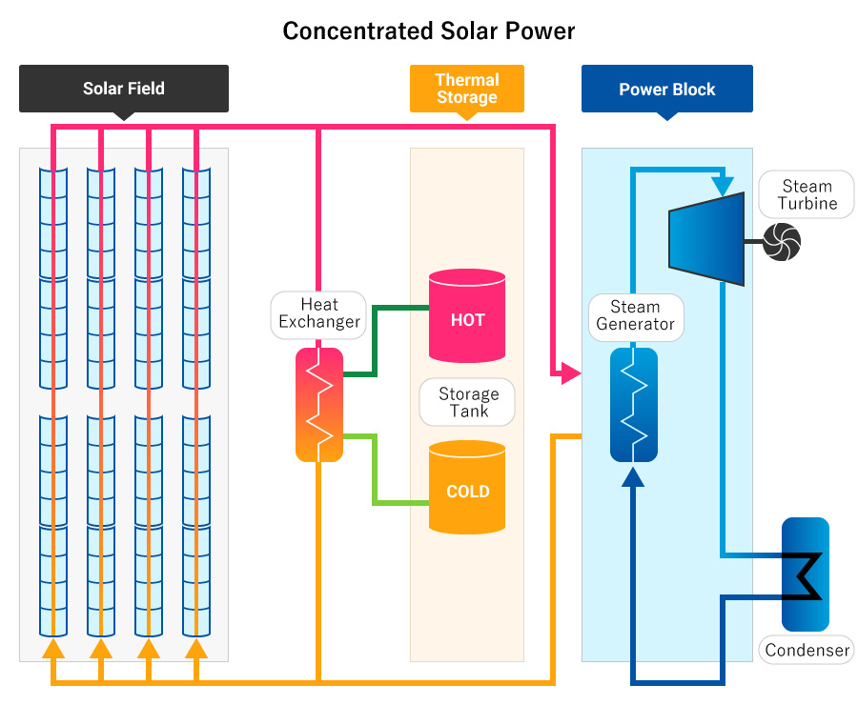
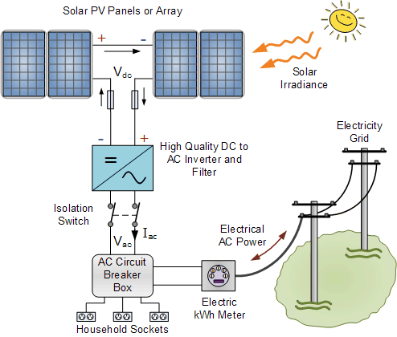
diagram of csp and pv power station

Slide 15
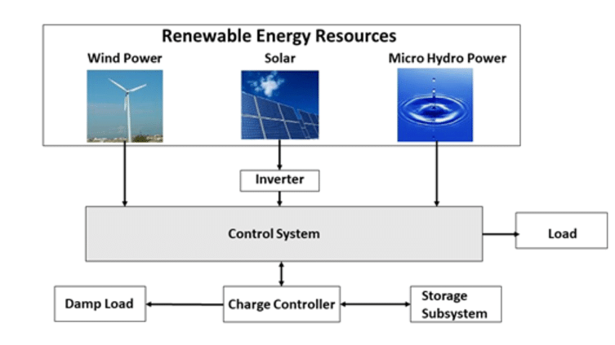
Block diagram of Renewable Energy Sources based on integrated system

Slide 16
advantages of Integration of renewable energy sources in smart grid
Reduce emissions
Reduce fuel costs
Integrate different sources of renewable energy into a single grid
Provide instant feedback on energy production and consumption
Provide energy according to demand, making it more efficient
A smart grid integrates various different technologies, including communications systems, smart meters, sensors and measurement devices, smart power generation devices, phasor measurement units and power system automation technologies, including AI.

Slide 17
disadvantages of Integration of renewable energy sources in smart grid
Continuous communication network should be available.
During emergency situation, network congestion or performance are big challenges in smart grid system
Cellular network providers do not provide guaranteed service in abnormal situations such as wind storm, heavy rain and lightening conditions.
Some smart meters can be hacked which can be used to increase or decrease the demand for power. It is expensive to install smart meter compare to traditional old electricity meter.

Slide 18


